Slide 1
Non-parametric: Mann Whitney tests [2 Independent samples]
When you want to test differences between two conditions and different participants have been used in each condition then you have two choices:
the Mann–Whitney test and (Independent)
the Wilcoxon rank-sum test (dependent)
These tests are the non-parametric equivalent of the independent t-test.

Slide 2
Effect of certain drugs on levels of depression
For example, a neurologist have collected data to investigate the depressant effects of certain recreational drugs.
She tested 20 clubbers in all: 10 were given an ecstasy tablet to take on a Saturday night and 10 were allowed to drink only alcohol.
Levels of depression were measured using the Beck Depression Inventory (BDI) the day after and midweek.

Slide 3
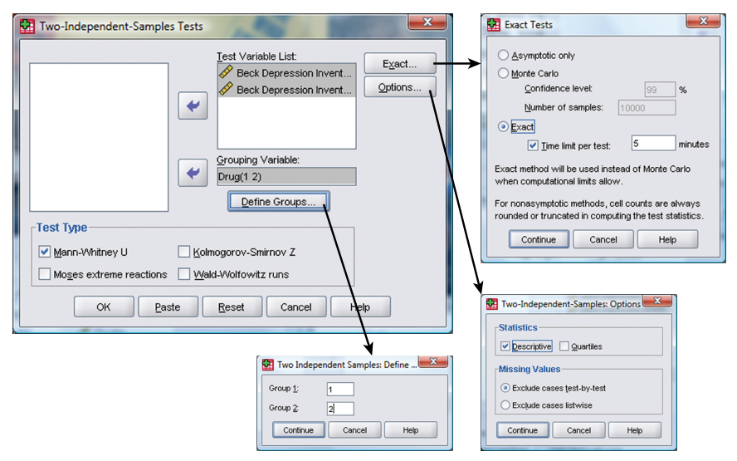
Mann Whitney test: analyzing data

Slide 4
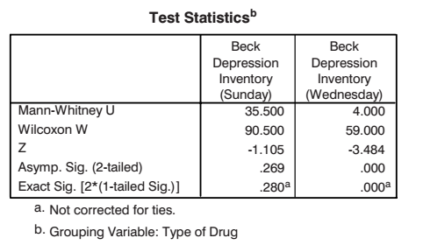
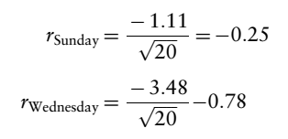

Out put
Calculating effect size

Slide 5
Reporting result from Mann Whitney test
Depression levels in ecstasy users (Mdn = 17.50) did not differ significantly from alcohol users (Mdn = 16.00) the day after the drugs were taken, U = 35.50, z = -1.11, ns, r = -.25. However, by Wednesday, ecstasy users (Mdn = 33.50) were significantly more depressed than alcohol users (Mdn = 7.50), U = 4.00, z = -3.48, p < .001, r = -.78.

Slide 6
Non-parametric: Wilcoxon rank-sum test (dependent) [2 Dependent samples]
To do the analysis we can use the same data as before, but because we want to look at the change for each drug separately, we can split file command and do the analysis for alcohol and ecstasy group separately.

Slide 7
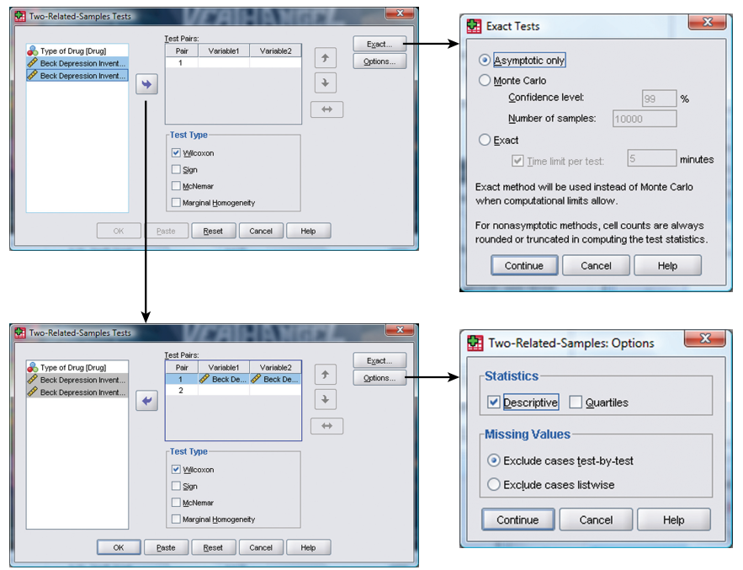

Slide 8
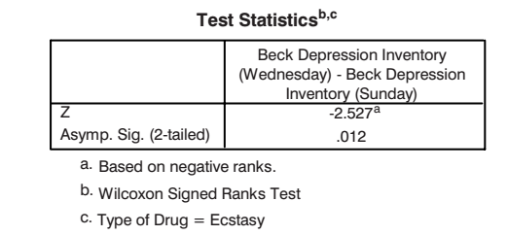
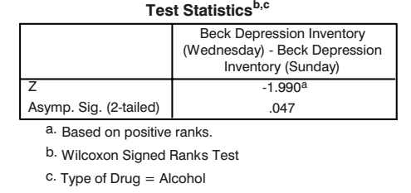
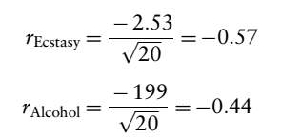
Output for ecstasy and Alcohol group
Calculating effect size
Reporting result of Wilcoxon signed rank test: For ecstasy users, depression levels were significantly higher on Wednesday (Mdn = 33.50) than on Sunday (Mdn = 17.50), T = 0, p < .05, r = -.57. However, for alcohol users the opposite was true: depression levels were significantly lower on Wednesday (Mdn = 7.50) than on Sunday (Mdn = 16.0), T = 8, p < .05, r = -.44.

Slide 9
Non-parametric: KrussKal-Wallis test (Comparing several means/medians) [more than 2 Independent samples]
The one-way independent ANOVA test for non-parametric data is the Kruskal–Wallis test. If you have data that have violated an assumption then this test can be a useful.

Slide 10
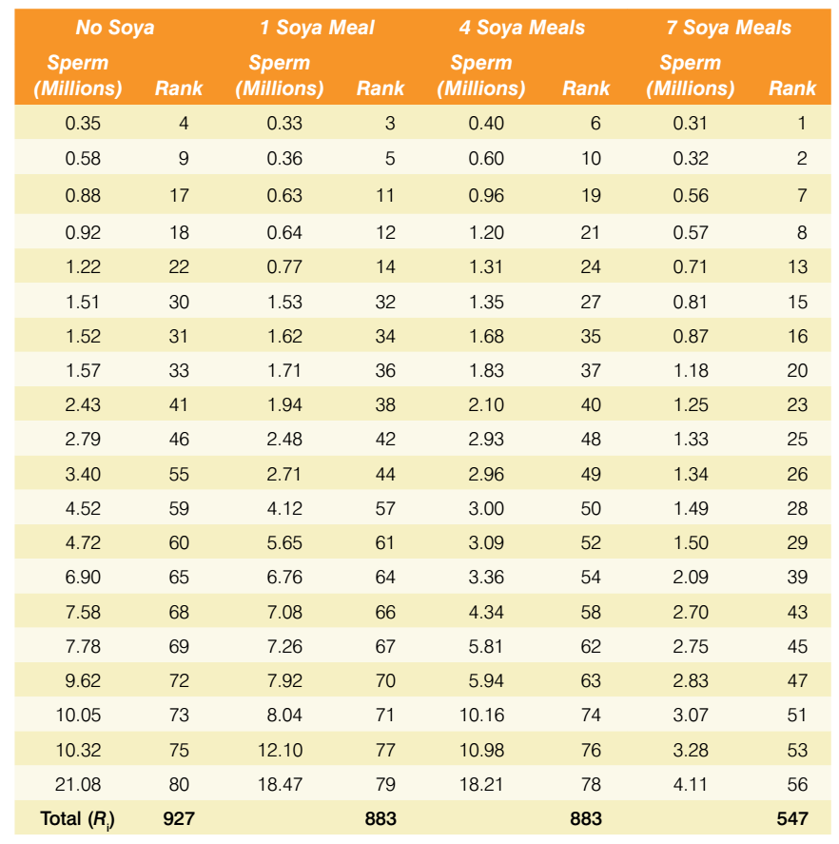
Data set: Soya eating and sperm production

Slide 11
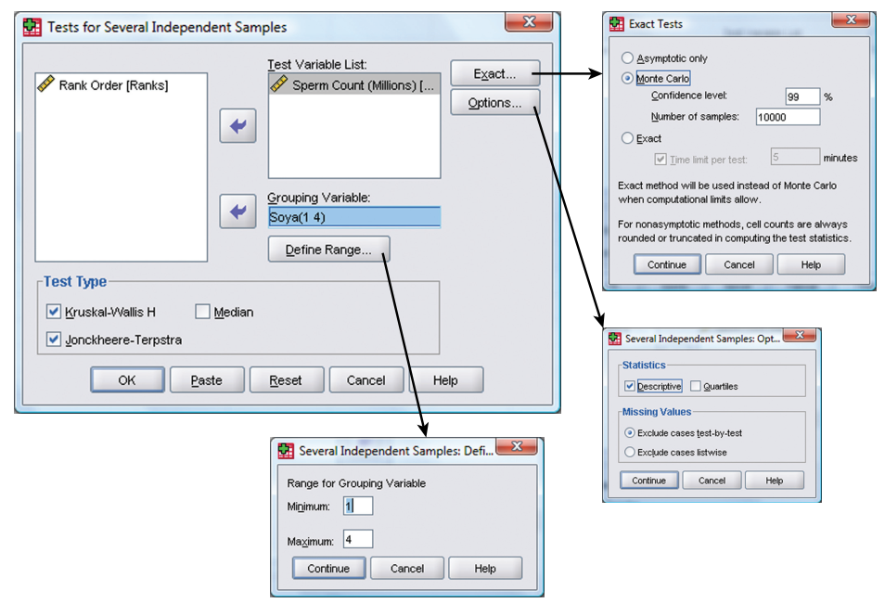
Procedure

Slide 12
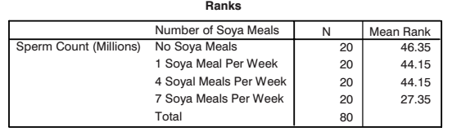
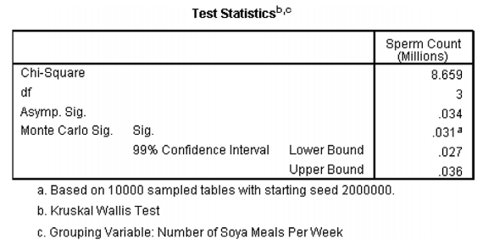
output

Slide 13
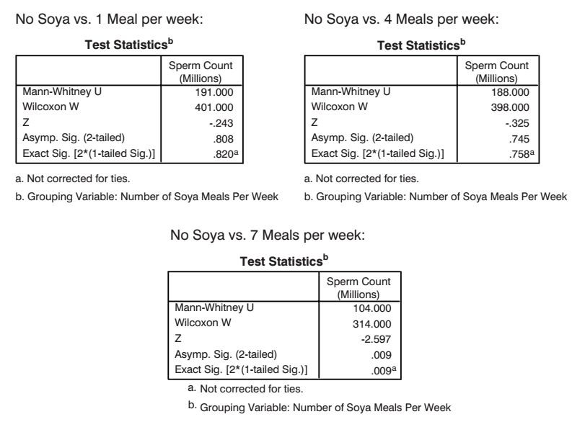

Slide 14
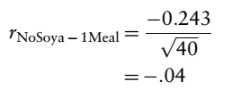
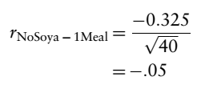
Calculating effect size
Reporting result:
Sperm counts were significantly affected by eating soya meals, H(3) = 8.66, p < .05.
Sperm counts were significantly affected by eating soya meals, H(3) = 8.66, p < .05. Mann–Whitney tests were used to follow up this finding. A Bonferroni correction was applied and so all effects are reported at a .0167 level of significance. It appeared that sperm counts were no different when one soya meal (U = 191, r = -.04) or four soya meals (U = 188, r = -.05) were eaten per week compared to none. However, when seven soya meals were eaten per week sperm counts were significantly lower than when no soya was eaten (U = 104, r = -.41). We can conclude that if soya is eaten every day it significantly reduces sperm counts compared to eating none; however, eating soya less than every day has no significant effect on sperm counts.

